Slide 1
Main Memory

Slide 2
Goals for Today
Protection: Address Spaces
What is an Address Space?
How is it Implemented?
Address Translation Schemes
Segmentation
Paging
Multi-level translation
Inverted page tables
Notes:
2

Slide 3
Virtualizing Resources
Physical Reality: Different Processes/Threads share the same hardware
Need to multiplex CPU (temporal)
Need to multiplex use of Memory (spatial)
Need to multiplex disk and devices (later in term)
Why worry about memory sharing?
The complete working state of a process and/or kernel is defined by its data in memory (and registers)
Probably don’t want different threads to even have access to each other’s memory (protection)
Notes:
3

Slide 4
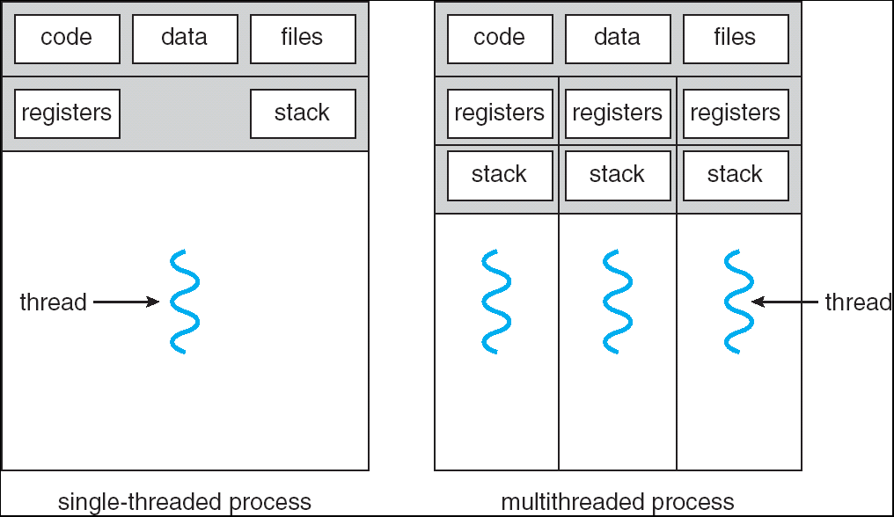
Recall: Single and Multithreaded Processes
Threads encapsulate concurrency
“Active” component of a process
Address spaces encapsulate protection
E.g. Keeps buggy program from trashing the system
Notes:
4

Slide 5
Important Aspects of Memory Multiplexing
Isolation
Separate state of processes should not collide in physical memory.
Obviously, unexpected overlap causes chaos!
Sharing
Conversely, would like the ability to overlap when desired
for communication
Virtualization
Create the illusion of more resources than there exist in the underlying physical system
Notes:
5

Slide 6
Binding of Instructions and Data to Memory
Binding of instructions and data to addresses:
Choose addresses for instructions and data from the standpoint of the processor
Could we place data1, start, and/or checkit at different addresses?
Yes
When? Compile time/Load time/Execution time
data1: dw 32
…
start: lw r1,0(data1)
jal checkit
loop: addi r1, r1, -1
bnz r1, r0, loop …
checkit: …
0x300 00000020
… …
0x900 8C2000C0
0x904 0C000340
0x908 2021FFFF
0x90C 1420FFFF
…
0xD00 …
Notes:
6

Slide 7
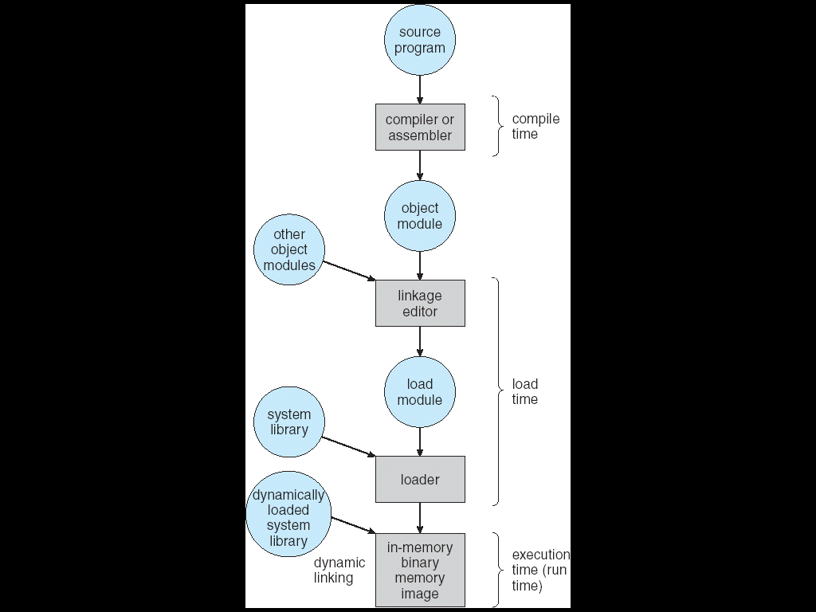
Multi-step Processing of a Program for Execution
Preparation of a program for execution involves components at
Compile time (i.e. “gcc”)
Link/Load time (unix “ld” does link)
Execution time (e.g. dynamic libs)
Addresses can be bound to final values anywhere in this path
Depends on hardware support
Also depends on operating system
Dynamic Libraries
Linking postponed until execution
Small piece of code, stub, used to locate the appropriate memory-resident library routine
Stub replaces itself with the address of the routine, and executes routine
Notes:
7

Slide 8
Recall: Uniprogramming
Uniprogramming (no Translation or Protection)
Application always runs at same place in physical memory since only one application at a time
Application can access any physical address
Application given illusion of dedicated machine by giving it reality of a dedicated machine
Of course, this doesn’t help us with multithreading
0xFFFFFFFF
Operating
System
Valid 32-bit
Addresses
Application
0x00000000
Notes:
8

Slide 9
Multiprogramming (First Version)
Multiprogramming without Translation or Protection
Must somehow prevent address overlap between threads
Trick: Use Loader/Linker: Adjust addresses while program loaded into memory (loads, stores, jumps)
Everything adjusted to memory location of program
Translation done by a linker-loader
Was pretty common in early days
With this solution, no protection
bugs in any program can cause other programs to crash or even the OS
0xFFFFFFFF
Operating
System
Application2
0x00020000
Application1
0x00000000
Notes:
9

Slide 10
Multiprogramming (Version with Protection)
Can we protect programs from each other without translation?
Yes: use two special registers base and limit to prevent user from straying outside designated area
If user tries to access an illegal address, cause an error
During switch, kernel loads new base/limit from TCB
User not allowed to change base/limit registers
0xFFFFFFFF
Operating
System
Limit=0x10000
0x00020000
Base=0x20000
Application2
Application1
0x00000000
Notes:
10

Slide 11
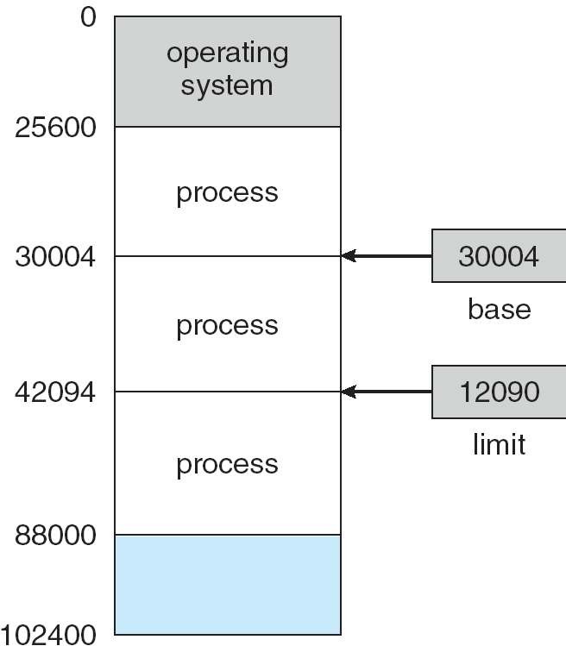
Base and Limit Registers
A pair of base and limit registers define the logical address space

Slide 12
Multiprogramming (Translation and Protection v. 2)
Problem: Run multiple applications in such a way that they are protected from one another
Goals:
Isolate processes and kernel from one another
Allow flexible translation that:
Doesn’t lead to fragmentation
Allows easy sharing between processes
Allows only part of process to be resident in physical memory
(Some of the required) Hardware Mechanisms:
General Address Translation
Flexible: Can fit physical chunks of memory into arbitrary places in users address space
Not limited to small number of segments
Think of this as providing a large number (thousands) of fixed-sized segments (called “pages”)
Dual Mode Operation
Protection base involving kernel/user distinction
Notes:
12

Slide 13
Memory Background
Program must be brought (from disk) into memory and placed within a process for it to be run
Main memory and registers are only storage CPU can access directly
Register access in one CPU clock (or less)
Main memory can take many cycles
Cache sits between main memory and CPU registers
Protection of memory required to ensure correct operation

Slide 14
Memory-Management Unit (MMU)
Hardware device that maps virtual to physical address
In MMU scheme, the value in the relocation register is added to every address generated by a user process at the time it is sent to memory
The user program deals with logical addresses; it never sees the real physical addresses

Slide 15
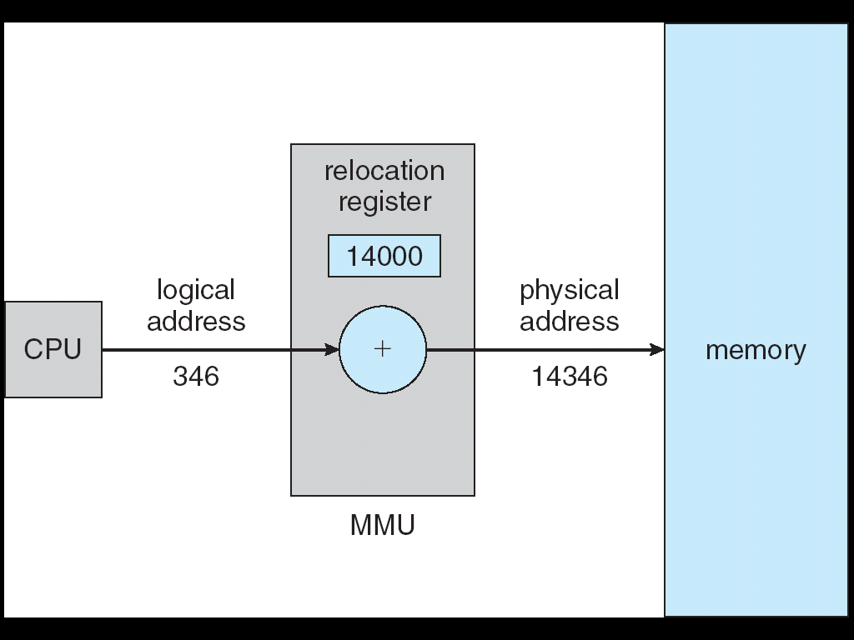
Dynamic relocation using a relocation register

Slide 16
Dynamic Loading
Routine is not loaded until it is called
Better memory-space utilization; unused routine is never loaded
Useful when large amounts of code are needed to handle infrequently occurring cases (error handling)
No special support from the OS needed

Slide 17
Dynamic Linking
Linking postponed until execution time
Small piece of code, stub, used to locate the appropriate memory-resident library routine
Stub replaces itself with the address of the routine, and executes the routine
OS checks if routine is in processes’ memory address
Also known as shared libraries (e.g. DLLs)

Slide 18
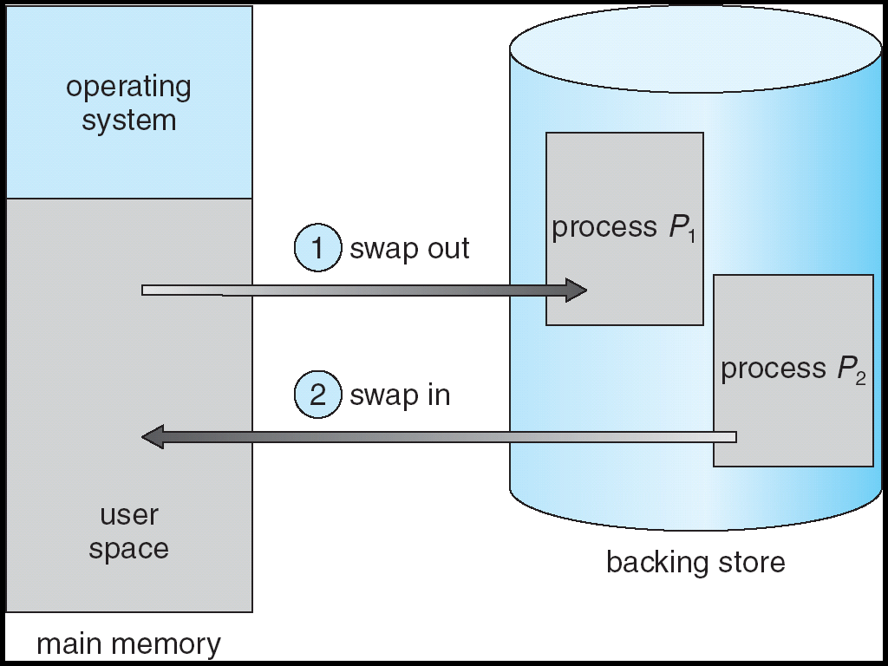
Swapping
A process can be swapped temporarily out of memory to a backing store, and then brought back into memory for continued execution
Major part of swap time is transfer time; total transfer time is directly proportional to the amount of memory swapped

Slide 19
Contiguous Allocation
Main memory usually into two partitions:
Resident OS, usually held in low memory with interrupt vector
User processes then held in high memory
Relocation registers used to protect user processes from each other, and from changing operating-system code and data
Base register contains value of smallest physical address
Limit register contains range of logical addresses – each logical address must be less than the limit register
MMU maps logical address dynamically

Slide 20
Contiguous Allocation (Cont.)
Multiple-partition allocation
Hole – block of available memory; holes of various size are scattered throughout memory
When a process arrives, it is allocated memory from a hole large enough to accommodate it
Operating system maintains information about: a) allocated partitions b) free partitions (hole)
OS
OS
OS
OS
process 5
process 5
process 5
process 5
process 9
process 9
process 8
process 10
process 2
process 2
process 2
process 2

Slide 21
Dynamic Storage-Allocation Problem
First-fit: Allocate the first hole that is big enough
Best-fit: Allocate the smallest hole that is big enough; must search entire list, unless ordered by size
Produces the smallest leftover hole
Worst-fit: Allocate the largest hole; must also search entire list
Produces the largest leftover hole

Slide 22
Fragmentation
External Fragmentation – total memory space exists to satisfy a request, but it is not contiguous
Internal Fragmentation – allocated memory may be slightly larger than requested memory; this size difference is memory internal to a partition, but not being used

Slide 23
Paging

Slide 24
Paging - overview
Logical address space of a process can be noncontiguous; process is allocated physical memory whenever the latter is available
Divide physical memory into fixed-sized blocks called frames (size is power of 2, between 512 bytes and 8,192 bytes)
Divide logical memory into blocks of same size called pages
Keep track of all free frames.To run a program of size n pages, need to find n free frames and load program
Set up a page table to translate logical to physical addresses
What sort of fragmentation?

Slide 25
Address Translation Scheme
Address generated by CPU is divided into:
Page number (p) – used as an index into a page table which contains base address of each page in physical memory
Page offset (d) – combined with base address to define the physical memory address that is sent to the memory unit
For given logical address space 2^{m} and page size 2^{n}
page number
page offset
p
d
m - n
n

Slide 26
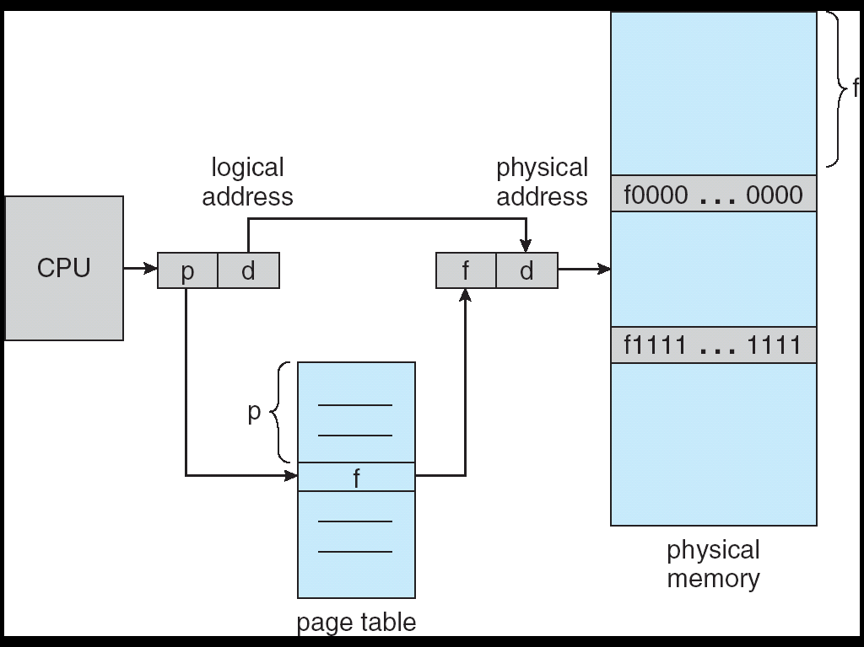
Paging Hardware

Slide 27
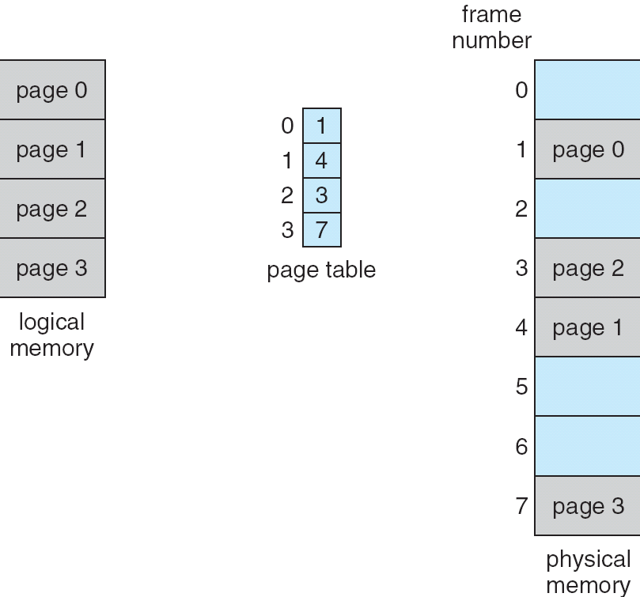
Paging Model of Logical and Physical Memory

Slide 28
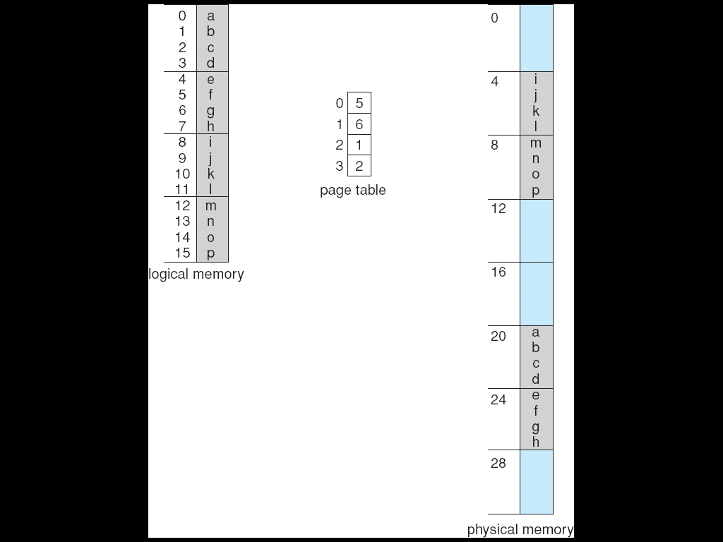
Paging Example
32-byte memory and 4-byte pages

Slide 29
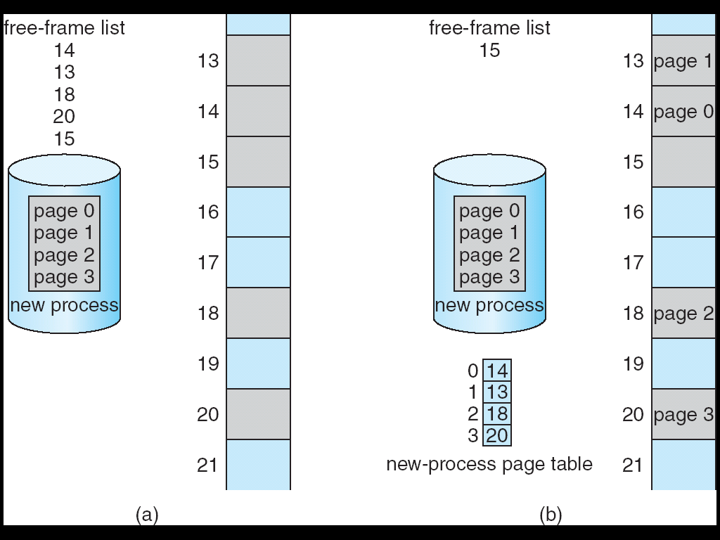
Free Frames
Before allocation
After allocation

Slide 30
Implementation of Page Table
Page table can be kept in main memory
Page-table base register (PTBR) points to the page table
Page-table length register (PRLR) indicates size of the page table
In this scheme every data/instruction access requires two memory accesses. One for the page table and one for the data/instruction.

Slide 31
Translation look-aside buffers (TLBs)
The two memory access problem can be solved by the use of a special fast-lookup hardware cache ( an associative memory)
Allows parallel search of all entries.
Address translation (p, d)
If p is in TLB get frame # out (quick!)
Otherwise get frame # from page table in memory

Slide 32
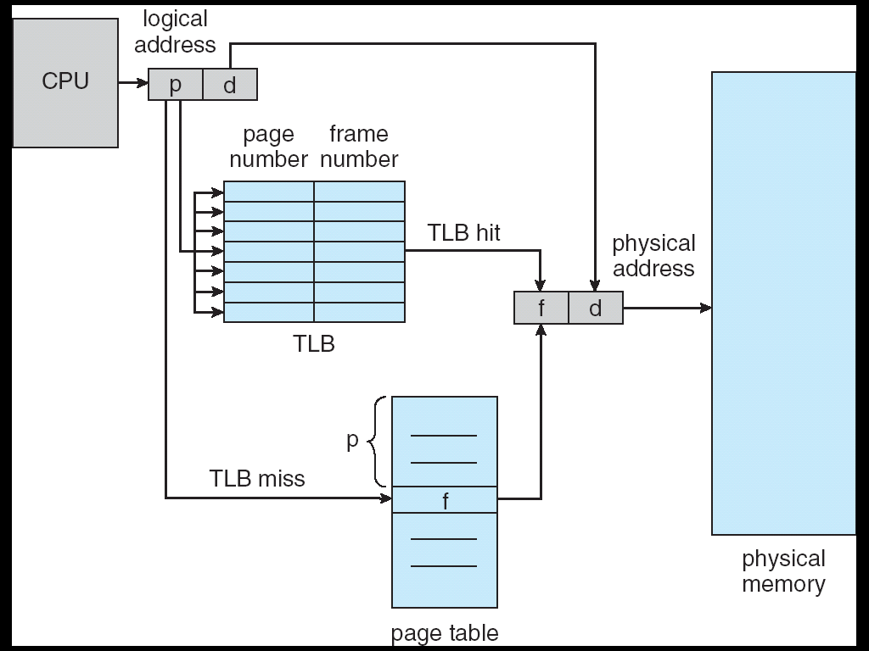
Paging Hardware With TLB

Slide 33
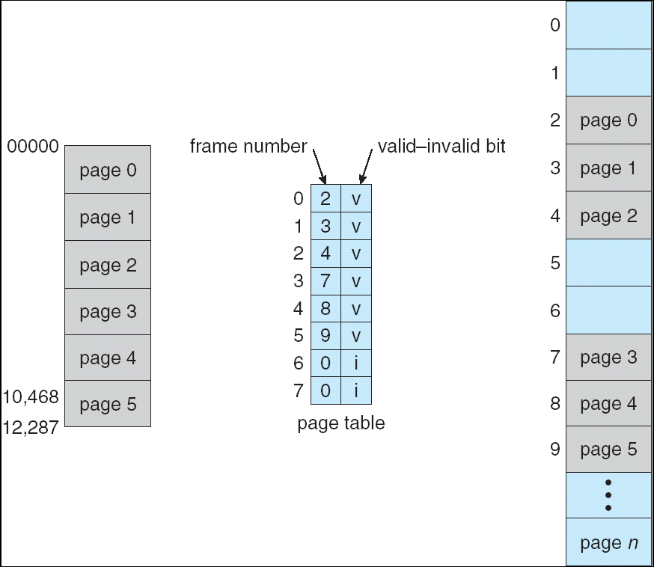
Memory Protection
Implemented by associating protection bit with each frame

Slide 34
Shared Pages
Shared code
One copy of read-only (reentrant) code shared among processes (i.e., text editors, compilers, window systems).
Shared code must appear in same location in the logical address space of all processes
Private code and data
Each process keeps a separate copy of the code and data
The pages for the private code and data can appear anywhere in the logical address space

Slide 35
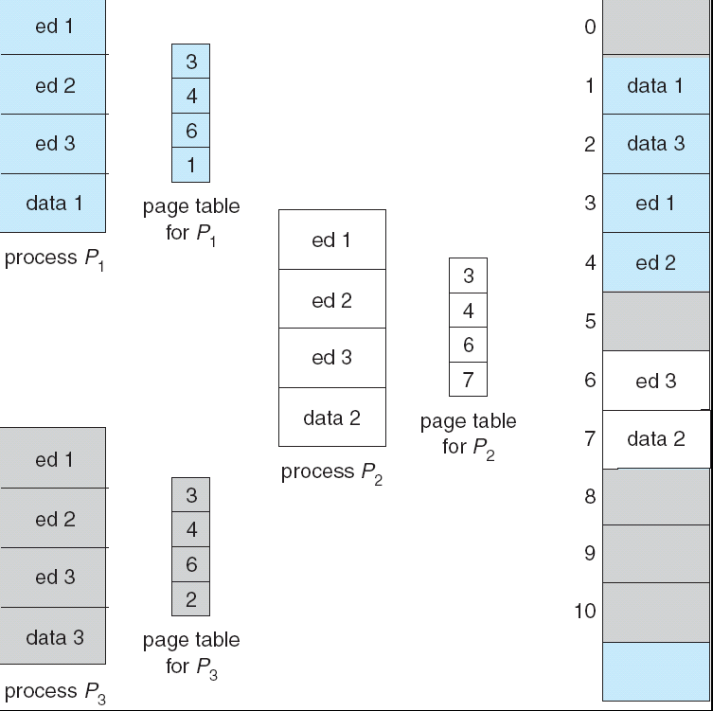
Shared Pages Example

Slide 36
Structure of the Page Table
Hierarchical Paging
Hashed Page Tables
Inverted Page Tables

Slide 37
Hierarchical Page Tables
Break up the logical address space into multiple page tables
A simple technique is a two-level page table

Slide 38
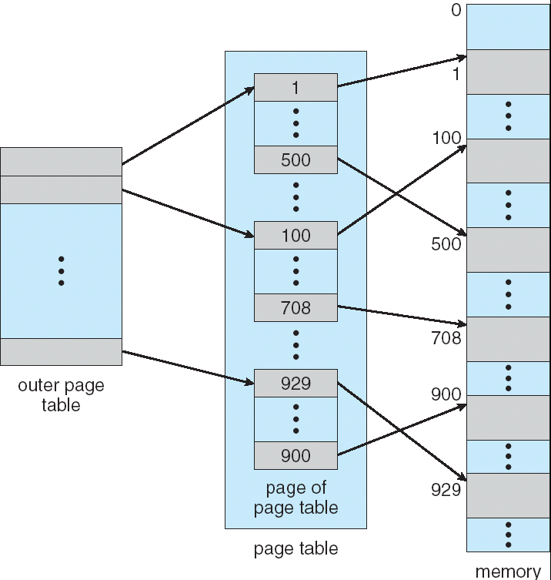
Two-Level Page-Table Scheme

Slide 39
Two-Level Paging Example
A logical address (on 32-bit machine with 1K page size) is divided into:
a page offset of 10 bits (1024 = 2^10)
a page number of 22 bits (32-10)
Since the page table is paged, the page number is further divided into:
a 12-bit page number
a 10-bit page offset
Thus, a logical address is as follows:
page number
page offset
p_{i}
p₂
d
12
10
10

Slide 40
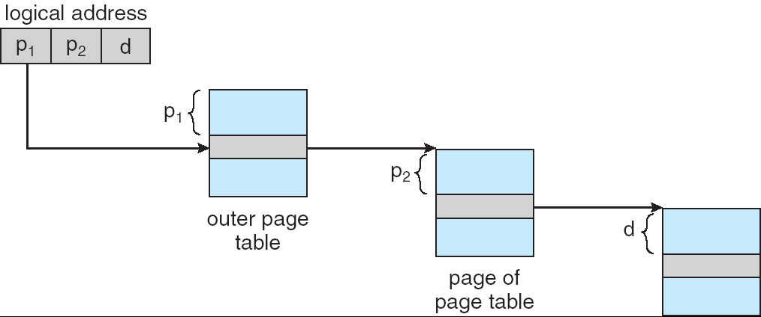
Address-Translation Scheme

Slide 41
Hashed Page Tables
Common in address spaces > 32 bits
The virtual page number is hashed into a page table. This page table contains a chain of elements hashing to the same location.
Virtual page numbers are compared in this chain searching for a match. If a match is found, the corresponding physical frame is extracted.

Slide 42
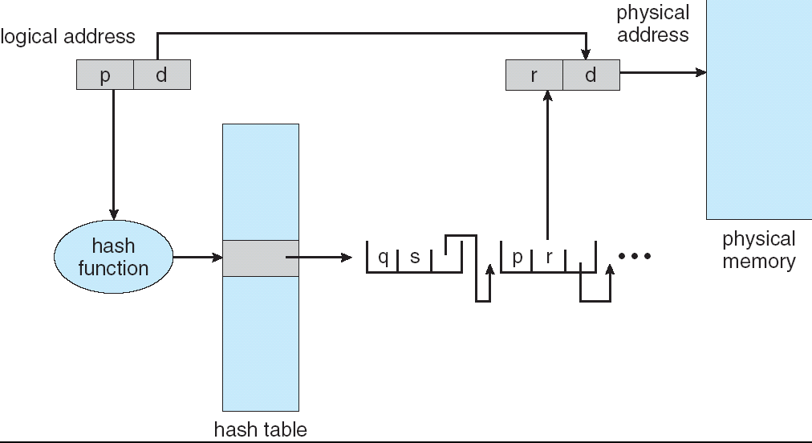
Hashed Page Table

Slide 43
Inverted Page Table
One entry for each real page of memory
Entry consists of the virtual address of the page stored in that real memory location, with information about the process that owns that page
Decreases memory needed to store each page table, but increases time needed to search the table when a page reference occurs
Use hash table to limit the search to one — or at most a few — page-table entries

Slide 44
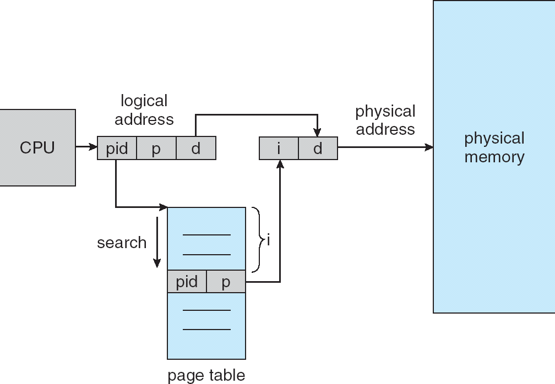
Inverted Page Table Architecture

